Slide 1
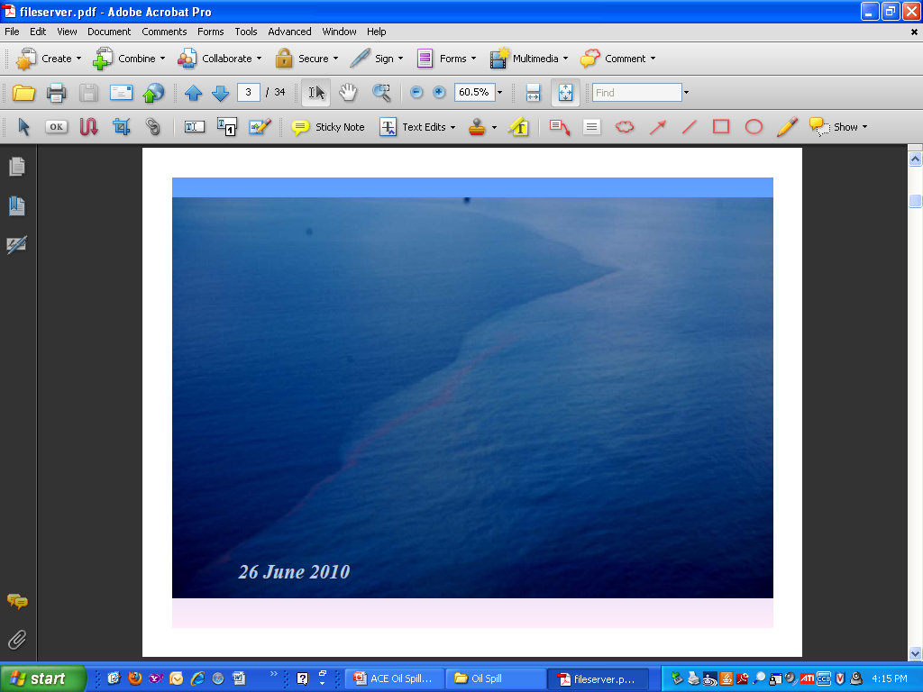


Longer Term Public Health Implications of Disasters:
The Deepwater Horizon Oil Spill
Edward J. Trapido, Sc.D., F.A.C.E.
Associate Dean for Research
LSUHSC School of Public Health
Professor and Wendell Gauthier Chair for Cancer Epidemiology
Coordinator of Gulf Oil Spill Research,
LSU Health Sciences Center at New Orleans
Photo: 6/26/10

Slide 2
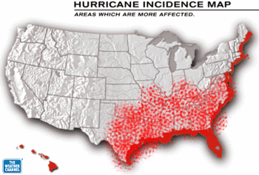
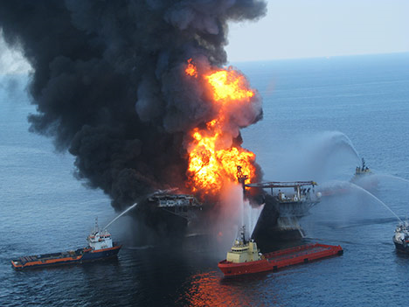
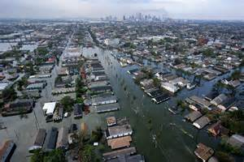
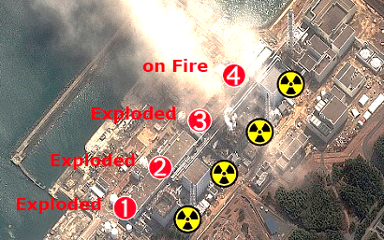
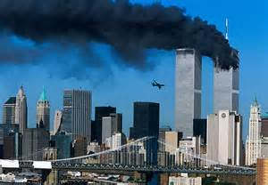
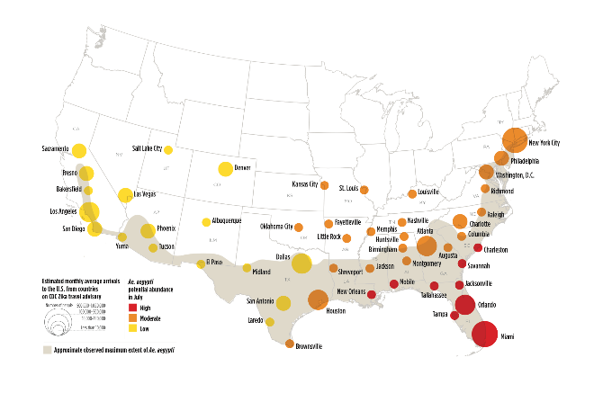
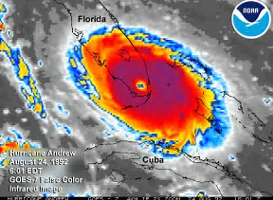
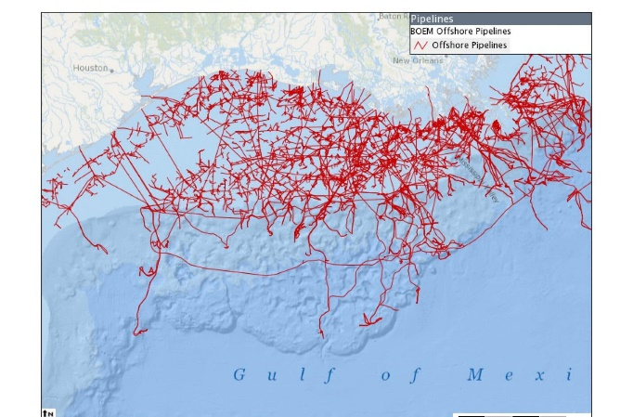
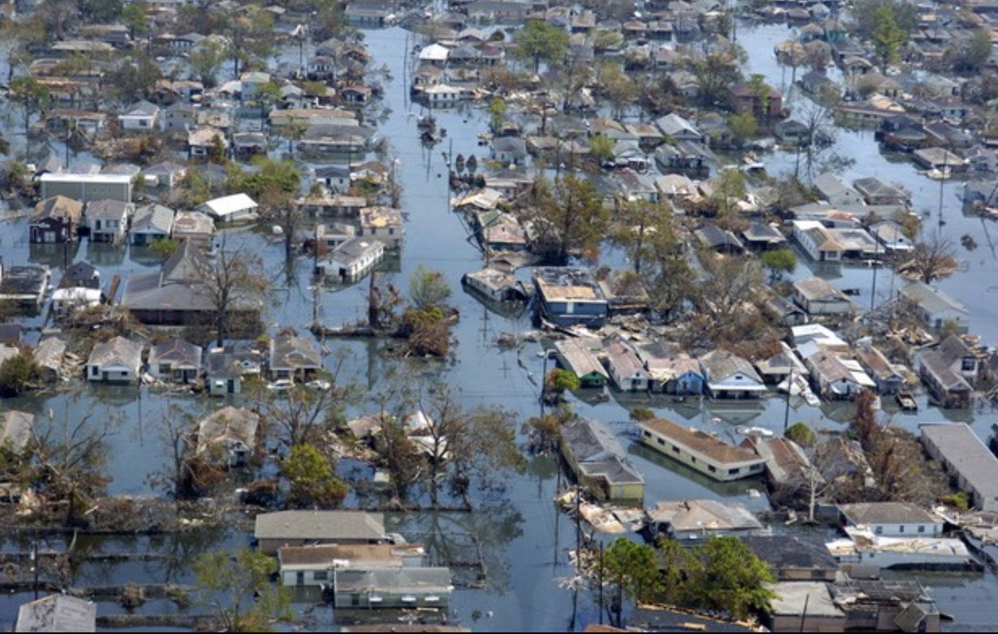
DWH KATRINA
Natural or (Hu)Man-Made Disasters
EAST BR
ANDREW

Slide 3
Disasters & Public Health
Lead to increased death, illness, and disability
Large economic impacts
Large social impacts
Impact invariably unequal across populations

Slide 4
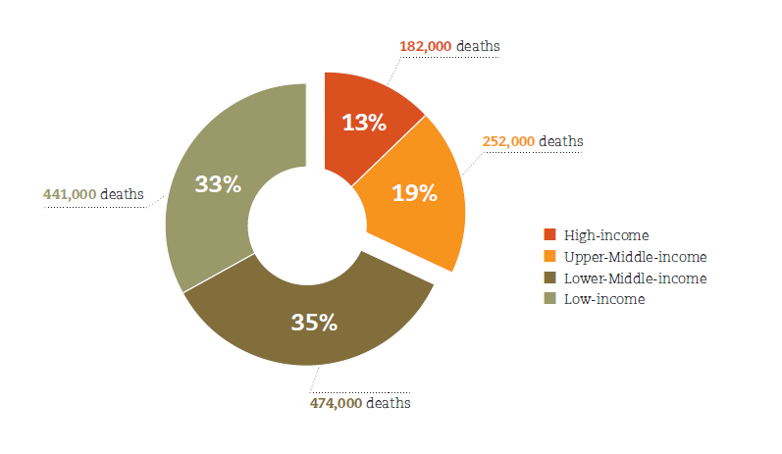
Number of deaths per income group (1994-2013), and Number Per million inhabitants
Very old, very young and very sick are most vulnerable

Slide 5
Public Health Needs
The main relief needs in natural disasters are clean water, food, sanitation, and shelter
In acute disasters, such as earthquakes and cyclones, physical trauma may require specialized interventions
The probability of survival from serious injury decreases substantially 12 to 24 hours after the disaster strikes, and good outcomes in most cases are thus highly dependent on the rapidity of appropriate medical and surgical responses
http://www.nejm.org/doi/full/10.1056/NEJMra1109877

Slide 6
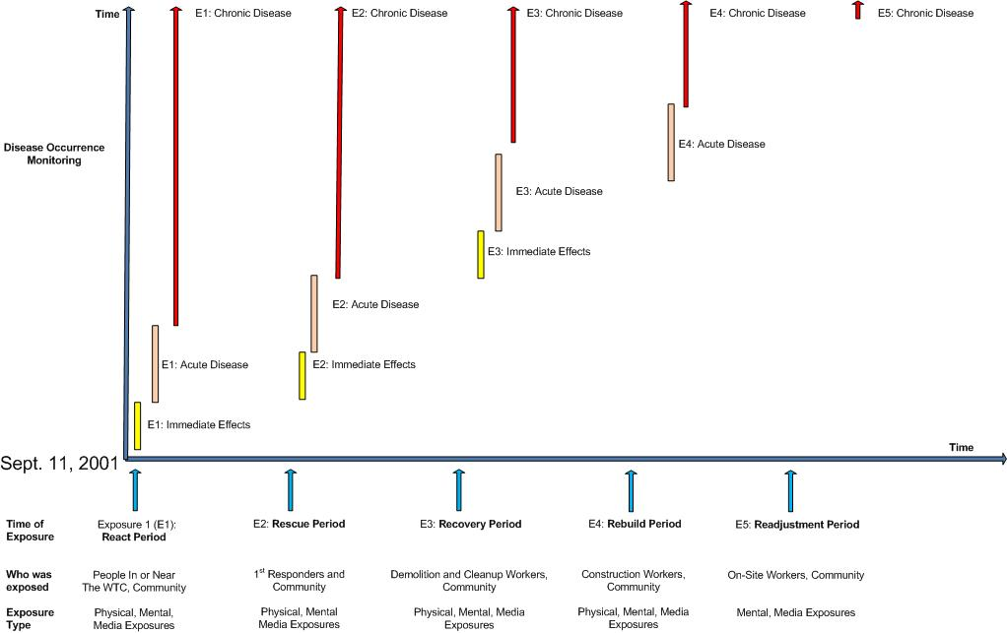
Case Example: 9/11 Attack

Slide 7
Identifying Persons Health/Disease Related Services
Rarely a surveillance system
Development of protocol for identification of illnesses and disease follow-up (harder to do when infrastructure destroyed)
Few trained to assess mental and physical health effects of complex exposures
Some verifiable, others not
Who pays for treatment

Slide 8
Exposure Not a Single Point in Time
Spill began 4/20/2010 and was capped 9/21/2010
Active clean-up ended 4/16/2014
Litigation continues
Most of population had been through Katrina, Rita, Gustavo, so it was already stressed
Every tropical storm, hurricane, oil spill, news story, movie, anniversary, ad for litigation, etc. may rekindle feelings and thoughts

Slide 9
Determining Exposure
General populations, first responders, clean-up workers, medical personnel, patients, occupational groups
Children, pregnant and non-pregnant women, men, elderly, immunocompromised or handicapped individuals, etc.

Slide 10
Exposures from Oil Spills
Direct Exposure
  Crude oil contains toxic components to humans
    Aromatic/aliphatic hydrocarbons
    Hydrogen sulfide gas
    Sulfonic acid
  Exposures could result in respiratory and dermal irritations, central nervous system depression, etc.
Indirect Exposure
  Social and economic disruption
  May lead to mental and physical health consequences
  Physical problems may lead to mental health consequences
Notes:
Specific to the DHOS, residents rely on the fishing and tourism industries for their livelihood, which were severely affected by the DHOS

Slide 11
Health Effects
Immediate Physical Effects
  Death, injuries
  Some depend upon routes of exposure: burns, respiratory, GI, ocular, nausea, dizziness, work related
Immediate Mental Effects
  shock, grief, fear, disorientation, anger, behavioral, psychological manifestations of physical disease and vice versa

Slide 12
Health Effects
Midterm effects:
  modified by changes in diet, displaced populations, changes in behaviors (e.g., tobacco use); above plus pregnancies, birth outcomes, depression, anxiety
Long term effects:
  rare diseases, like cancer, are hard to measure and attribute
Genotoxic effects

Slide 13


Edward Trapido, ScD, FACE
Principle Investigator, WATCH Study
Louisiana State University School of Public Health

Slide 14
WaTCH Aims:
Women
To estimate the association between oil spill “exposure” and physical and emotional health outcomes including respiratory disease, rashes, headaches, depression and emotional distress.
Children
To understand the impacts of the Deepwater Horizon oil spill on children's development and well-being, and to examine how parental and social forces changes the spill's effects on children.
Notes:
Ongoing, prospective cohort study examining the short and long-term physical, mental, and community health effects resulting from the Deepwater Horizon Oil Spill among adult women and children residing in Southeastern Louisiana

Slide 15
Methods
Cohort of women from 7 Southeastern LA parishes
  Sample of ~2800 women and ~600 children
    Address based sampling frame of household telephone numbers
  Inclusion criteria:
    18-80 years (women); 10-17 years (children)
    Lived in one of seven target parishes on April 20, 2010
Bossier
Claiborne
Union
Morehouse
West
Carroll
East
Carroll
Caddo
Webster
Lincoln
Ouachita
Bienville
Jackson
Richland
Madison
DeSoto
Red
River
Caldwell
Franklin
Tensas
Natchitoches
Winn
Sabine
La Salle
Catahoula
Grant
Concordia
Vernon
Rapides
Avoyelles
West
Feliciana
East
Feliciana
St.
Helena
Washington
Beauregard
Allen
Evangeline
St. Landry
Pointe
E. Baton
Rouge
Tangipahoa
Coupee
WBR
Livingston
St. Tammany
Calcasieu
Jefferson
Davis
Acadia
Lafayette
St. Martin
Iberville
Ascension
St.
John
Iberia
St.
James
St.
Charles
Orleans
Cameron
Vermilion
Assumption
Jefferson
St. Martin
Lafourche
St. Bernard
St. Mary
Terrebonne
Plaquemines
Notes:
Women were identified through:
Address-based sampling
Referrals of friends and neighbors
Volunteers
Data collection
Computer-assisted telephone survey
Home visit
Biospecimens and anthropometric measureme

Slide 16
Participation
Wave I: July 2012 - August 2014
  2,852 women
  The questionnaire included detailed questions on demographic characteristics, physical and mental health history, exposure to the oil spill or its clean-up, medication use, lifestyle characteristics such as diet, smoking, alcohol consumption, physical activity, occupational history, and exposure to prior hurricanes and other exposure information. There were also questions regarding healthcare access, social support, social capital, resource loss, financial or economic hardship and other measures of resiliency.
Wave II: September 2014-June 2016
  2038 women
  Follow-up questions reassessed information collected during the baseline phone interview, including demographics, physical and mental health, behaviors and other exposures. New modules were added including questions to assess the following personal characteristics: conservation and loss of resources, resiliency, social capital, perceived stress, life events and post-traumatic stress.
Notes:
43.3% response rate = calculated by dividing the number of complete interviews by the number of eligible women using an estimate of the proportion of unknown eligibility cases that are eligible
AAPOR – American Association for Public Opinion Research

Slide 17
Exposure Assessment
Characteristic | N (%)
Economic Exposure DHOS
Lost HH income due to employment disruption/closing of business because of oil spill | 662 (26.6)
Hit harder by oil spill compared to others in community | 167 (6.0)
Oil spill had somewhat or very negative influence on HH financial situation | 1064 (37.84)
Physical/Environmental Exposure to DHOS
Oil spill caused damage to areas fished commercially | 195 (6.8)
Extent and frequency of smelling oil
No smell | 1694 (62.4)
Low smell | 293 (10.78)
Medium smell | 472 (17.4)
High smell | 258 (9.4)
Came into physical contact with oil in other ways | 624 (22.10)
Oil spill directly affected recreational hunting/fishing/other activities of household | 452 (15.9)
Work on any of the oil spill cleanup activities? | 47 (2.0)
Property that was lost or damaged because of the oil spill or cleanup? | 58 (2.4)
Notes:
Nine Binary Indicators

Slide 18
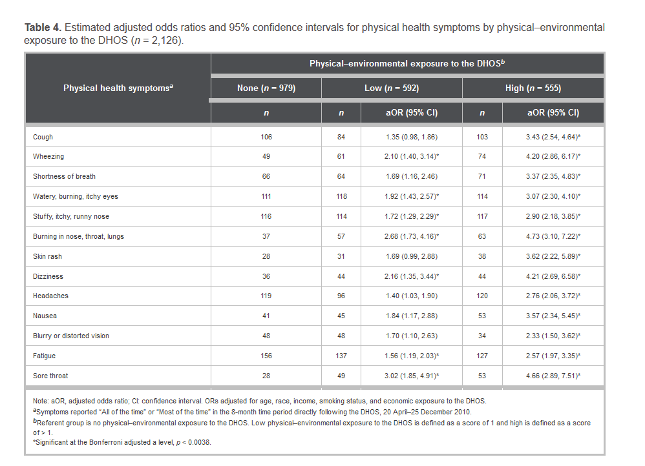
Physical Effects Wave I

Slide 19
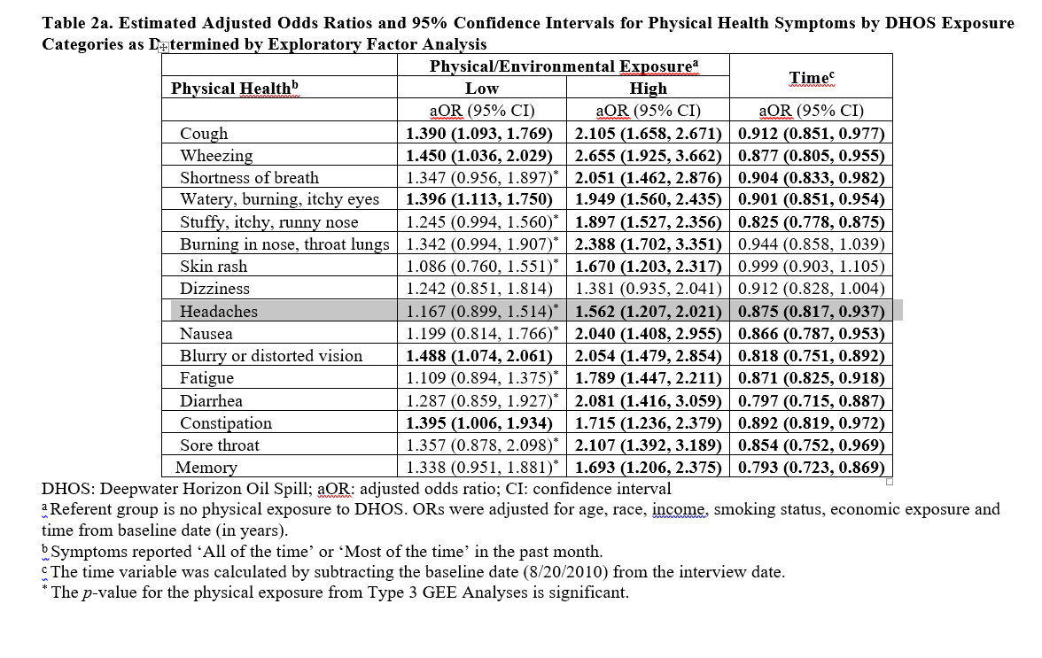
Physical Effects Wave II (unpublished data)

Slide 20
Mental Health
 | Wave 1 |  | Wave 2
Characteristic | Mean | SD | Mean | SD
Depressive Symptoms | 11.9 | 12.52 | 14.5 | 13.5 | ***
Presence of depressive symptoms (CESD >= 16) (n, %) | 572 | 28% | 722 | 36%
No depressive symptoms (CESD < 16) (n, %) | 1459 | 72% | 1310 | 65%
Mental Distress | 6.2 | 5.28 | 5.9 | 5.38 | ***
Severe mental distress (K6 >= 13) (n, %) | 262 | 13% | 268 | 13%
Moderate mental distress (K6 = 8-12) (n, %) | 406 | 20% | 321 | 16%
No mental distress (K6 < 8) (n, %) | 1359 | 67% | 1446 | 7%
*p<0.05, **p<0.001, ***p<0.0001 from Wilcoxon-signed rank tests between Waves 1 and 2
Missing data: Depressive symptoms (W1 n=7, W2 n=6); mental distress (W1 n=11, W2 n=3)
Note: Depressive symptoms measured with the Centers for Epidemiological Studies-Depression (CESD) scale; mental distress measured with the K6 scale.
scores calculated as sum of affirmative responses
PTSD, measured by the PCL, was also associated with exposure. https://www.mirecc.va.gov/docs/visn6/3_PTSD_CheckList_and_Scoring.pdf

Slide 21
Behavioral Health
Increase in tobacco use, alcohol use, intensity of family fights
Recidivism of these behaviors
Clear implications for actions/services

Slide 22
Resiliency
“the capacity of a system to withstand or recover from significant disturbances that threaten it”
Notes:
Resilience has been an often-discussed concept in the disaster field. We view it as a process rather than an outcome, and define it as the capacity of a system to withstand or recover from significant disturbances that threaten it.
Recently, there have been many calls for more research on resilience that can be applied to post-disaster settings.
Specifically, we are interested in how mental health in a post-disaster setting is shaped by resilience
Social ties
How people socialize, live, interact, relate to each other
Evidence linking this with health
Resilience
Capacity of a system to recover from significant disturbances
Process rather than outcome

Slide 23
Resiliency Attributes
Individual and community attributes.
  Individual resilience
    General Self-Efficacy, 10 item questionnaire
    Social support, 6 item questionnaire
  Community resilience
    Social cohesion
    Informal social control
    Neighborhood organization participation
Resilience activation
  whether any of 8 services were needed in the year following the oil spill. e.g. food, utilities, etc.
    Needed and did not receive the service, did not need the service, and needed and received the service.

Slide 24
SEM Model Results
Community resilience attributes
-
Resilience activation: receipt of needed services
-.060
Individual resilience attributes
+
.250
-.505
-
-.166
Total direct: 0.188 (.049), p<.001
Total indirect: .084 (.016), p<.001
Total: .272 (.047), p<.001
Exposure to
oil spill
+
.188
Depression
Notes:
1. The first thing we see is that exposure to the oil spill is positively associated w/depression (more exposure, more depression).
2. We also see that both individual and community resilience attributes were significantly associated with resilience activation. Individual resilience attributes were positively associated with resilience activation, which was expected, meaning that things like more self efficacy and more social support were related to more receipt of needed services. But community resilience was negatively associated with receipt of needed services, which was not expected. In other words, the more social cohesion and informal social control, the LESS activation occurred. This was unexpected and we will want to take a closer look at it. It is possible that exposure negatively affected community resilience attributes, which then negatively affected resilience activation.
3. We also see that exposure is negatively associated with resilience activation. (more exposure, less activation or receipt of needed services)
4. And that resilience activation negatively associated with depression. (more activation or more receipt of needed services, less depression) (these were in expected direction)
5. Moreover, this indirect pathway from exposure to activation to depression was also significant, meaning that resilience activation/receipt of needed services partially mediates the relationship between exposure and depression. 31% of the total effect of exposure to the spill on depression was explained by the mediating factor of resilience activation.

Slide 25
Resiliency Results
Resilience attributes, particularly individual ones such as general self-efficacy and social support, are predictive of resilience activation (receipt of needed services).
Resilience activation mediates the relationship between exposure to the oil spill and increased depression.
Relationship between exposure to the spill and increased depression is partially explained by the ability of participants to activate their resilience attributes, or to receive specific services that they needed.

Slide 26
Economic Effects
Clean-up and containment costs
Mitigation claims
Damage claims
Civil penalties
Criminal penalties
Loss of productivity
Loss of tourism
Lost jobs
Health effects require money for diagnosis, treatment, rehabilitation
Resettlement costs
Rebuilding costs

Slide 27
Need for Health Policy Formation
Overarching policy focus:
  Are harms mitigated?
  Are services available?
  How are services financed?
Timing
Initial emergency
Acute phase
Longer-term, chronic phase

Slide 28
Longer-Term, Chronic Phase
(More than 5 years post-event)
Emphasis on
  Ongoing needs of those still affected
    Who is still sick
    Why are they still sick
    What needs are still not being met and why
Less interest by Federal Agencies

Slide 29
9/11 Policy Making: Lessons Learned
Interplay between policymaking and scientific processes can be challenging and mistrustful
Developing mechanisms to interpret and communicate scientific finding to policymakers and the public may reduce mistrust
  Synthesize emerging findings into non-scientific reports (maintaining rigor)
  Develop mechanisms to help policymakers and media access body of evidence to date

Slide 30
Lessons Learned
  Disasters often expose or exacerbate larger structural inequities and challenges in communities
    Healthcare system inequities, inefficiencies, and expense;
    Disability adjudication problems
    Longstanding physical and mental health disparities
  Solutions for populations at risk for unmet health needs are a policy priority in most disasters
    Screen and refer directly affected groups for mental health symptoms
    Need for trained providers
    Dedicated outreach efforts to unaffiliated or marginalized groups
      Clean up and lower-skilled construction workers
      Lower SES affected communities

Slide 31
A team effort:
Edward Trapido (me)
Edward Peters
Ariane Rung
Daniel Harrington
Elizabeth Fontham
Evrim Oral
Lauren Perez
Samaah Sullivan
Symielle Gaston
Daesy Behrhorst
Lorna Thorpe, for WTC material
NIEHS

Slide 32
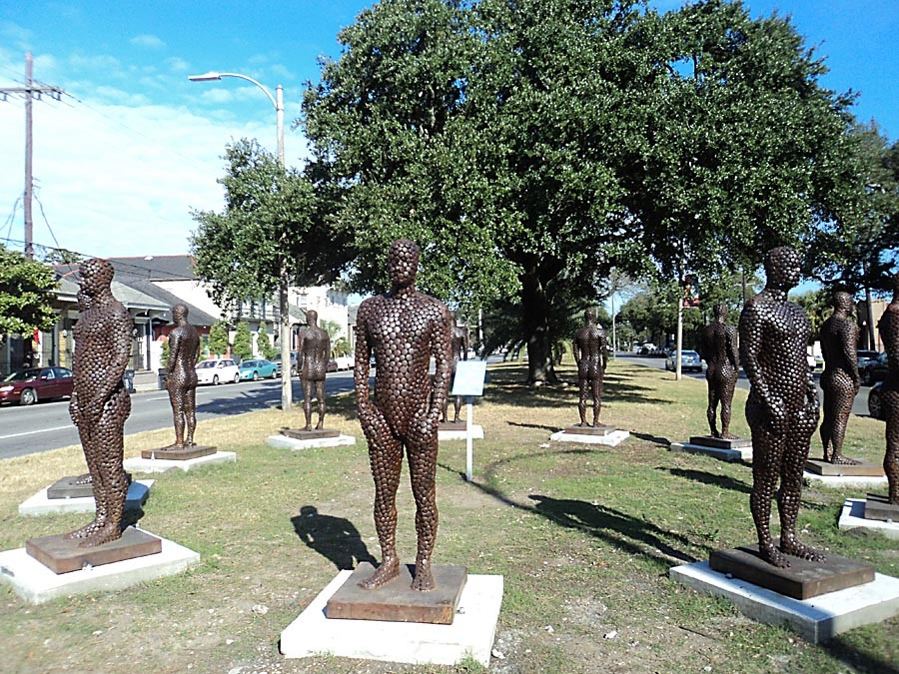
Thank you.
etrapi@lsuhsc.edu

